Slide 1
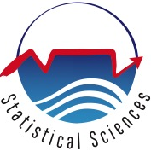

MMID: Seasonality
Dr Sheetal Silal

Slide 2
Seasonality
Why incorporate seasonality?
Some diseases are highly seasonal
Influenza – winter months
Measles – school terms
Malaria – mosquito breeding dependent
HIV, TB etc??
Depends on seasonal influences

Slide 3
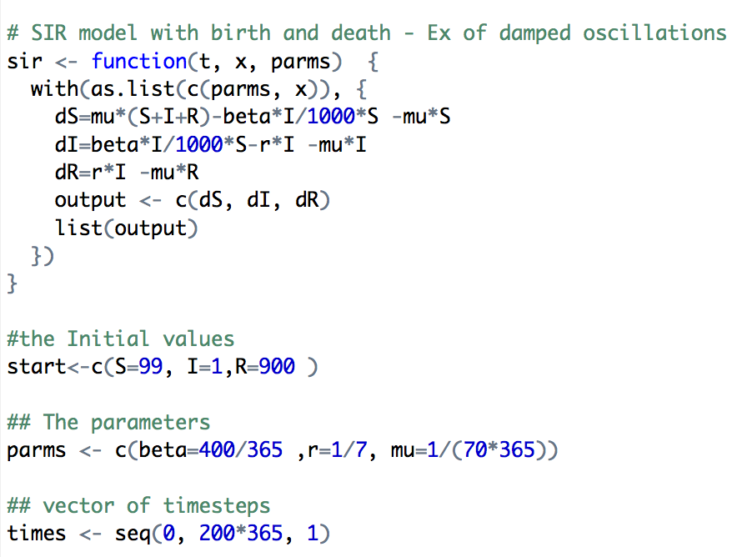
Damped Oscillations

Slide 4
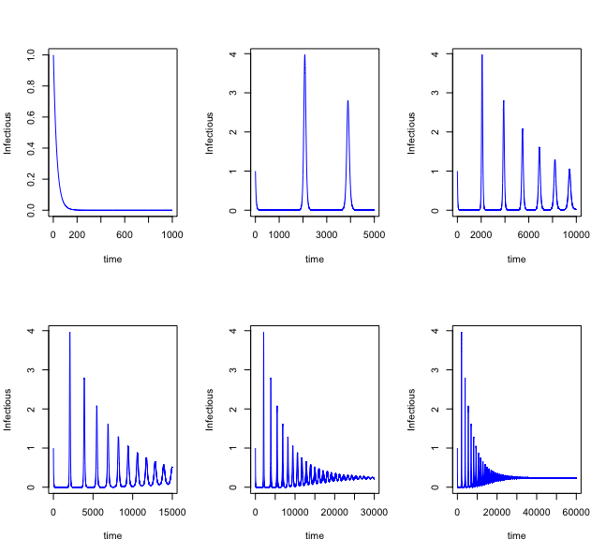
Damped Oscillations

Slide 5
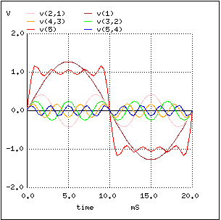
Seasonal Forcing functional forms
Square Pulses
Step functions
Cosine functions

Slide 6
Cos function: β_{t}= β₀(1+β₁cos(2πt))

Slide 7
Environmental factors
Create indices/functions to mimic environmental factors such as
Rainfall
Temperature
Climatic indices (SOI, El niño)
Migration patterns
Consider most influential factors forcing seasonality

